Slide 1
Surf 2022 group B Progress report 6

Slide 2
Contents
Dataset Image Size
256x256
512x512
Different Model
FastAI + EfficientNet
FastAI + ResNext50 + EfficientUnet
Further Improvements

Slide 3
Dataset Image Size

Slide 4
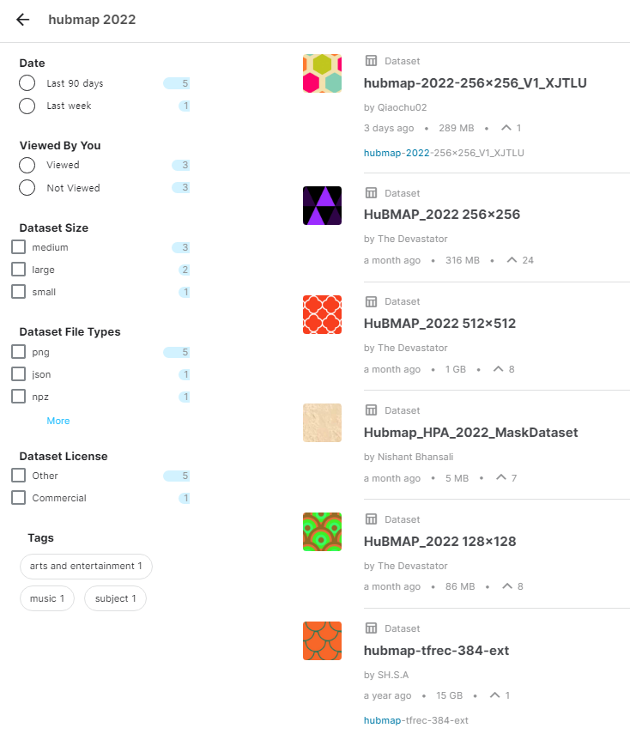
512x512 Tiling
From the previous work, we have done training with 256x256 tiled images.
Therefore, in this progress work, we have tried with larger tiling.
The largest image tiling size that is provided from the Kaggle datasets are 512x512.
Thus, we first tried implementing 512x512 in the training process.

Slide 5
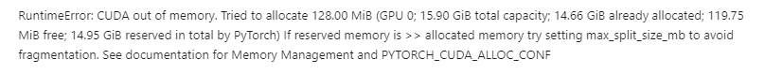
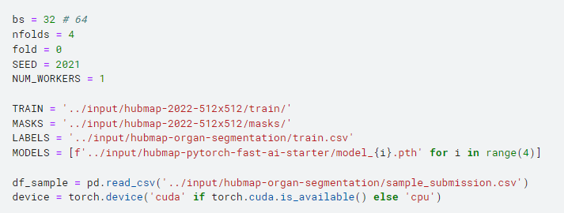
512x512 Tiling
With FastAI baseline:
RuntimeError: CUDA out of memory has arisen. This happens when GPU is out of memory.
I have first trained with batch size of 64, and now have adjusted to 32. It took around 5 hours to train with 64 batch size.
I am now training with 32 batch size and will put this forward on the next presentation.

Slide 6
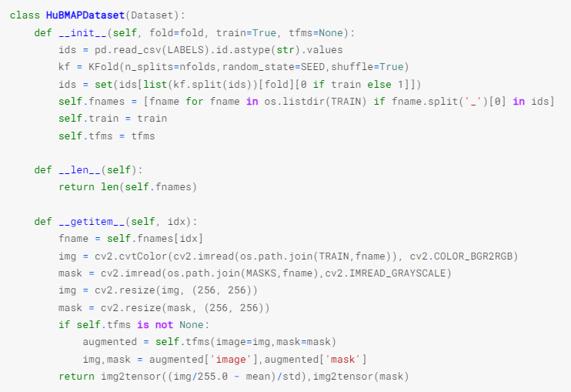
512x512 Tiling
Instead, another method we have tried is resizing 512x512 tiled images into 256x256.
When training, imported images are 512x512.
Then when loading the datasets, images and masks are resized to 256x256

Slide 7
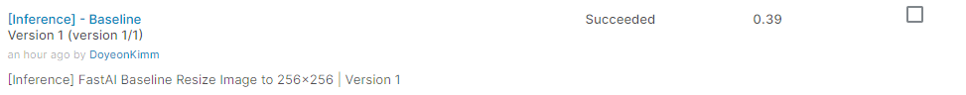
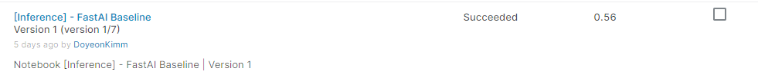
512x512 Tiling
From this process, the final score has been obtained to be 0.39.
This is even decreased from simple FastAI baseline with 256x256 tiled image training: 0.56 → 0.39
It is thought to be happened because when reducing the size of an image, the number of pixels are also reduced.
Therefore, to resize images to not to lose too much information, we need to do algorithm that tweaks the pixel values to merge/average them.
https://stackoverflow.com/questions/64292525/python-how-to-resizeshrink-image-without-losing-quality

Slide 8
Different Model

Slide 9
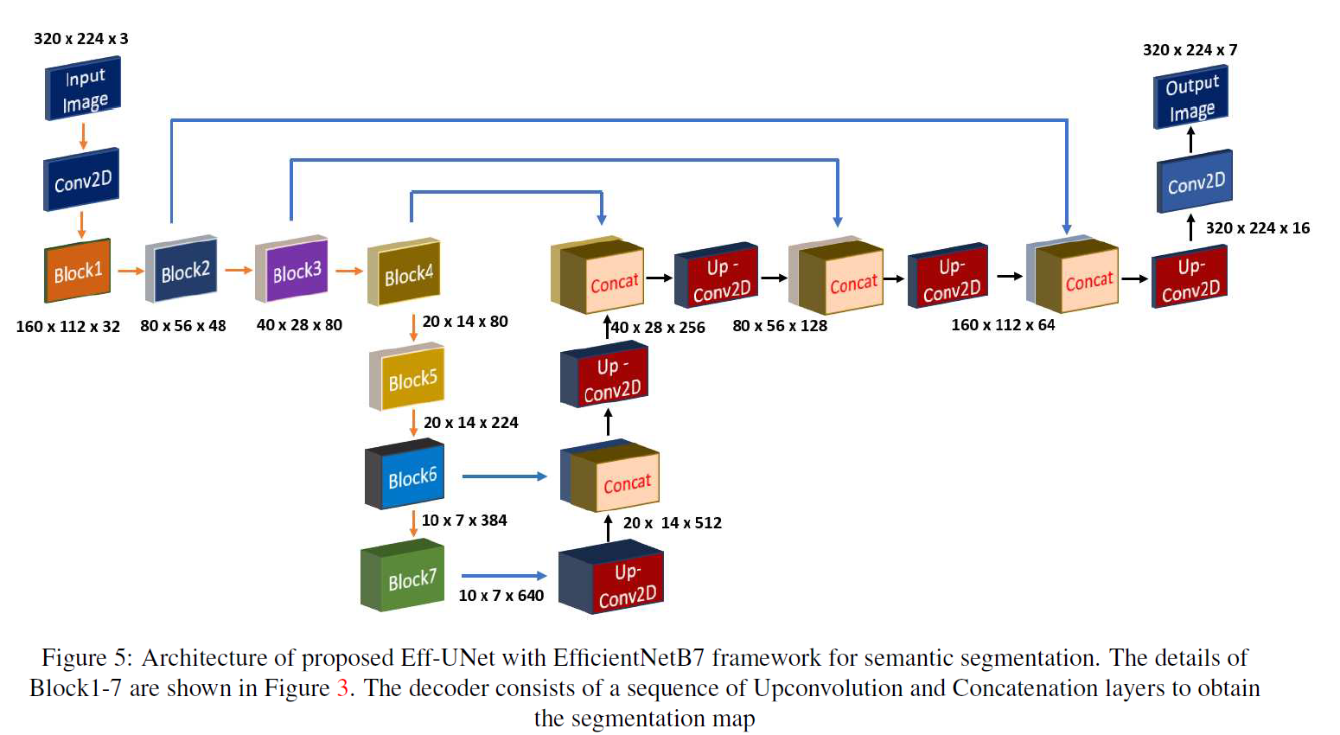
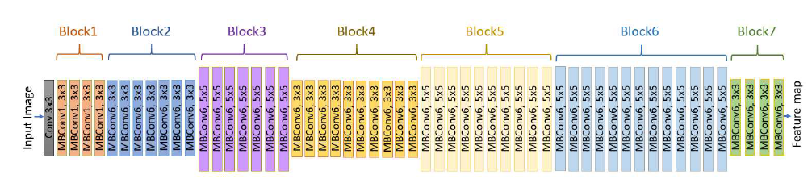
UneXt50 + EfficientUnet
From previous work, we have trained FastAI baseline with EfficientNet model.
In this time, we have tried FastAI baseline with UneXt50 and EfficientUnet combined model.
EfficientUnet works similar to Unet, but with EfficientNet structure.
https://ieeexplore.ieee.org/document/9150621
EfficientUnet:
EfficientNet-B7, Blocks 1-7:

Slide 10
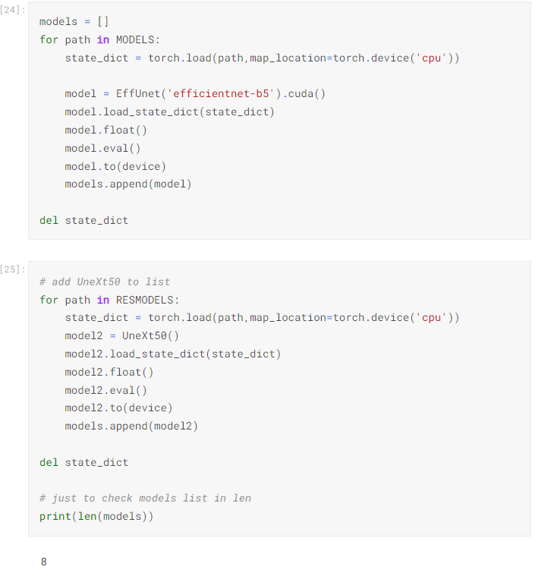
UneXt50 + EfficientUnet
From training, we have found that using UneXt50 and EfficientUnet together will slightly improve the result.
Adding input of both training results of the two models and then use them in ensemble steps has slightly improved the result to 0.69

Slide 11
Future Plans

Slide 12
Future Plans
The first place of last competition used ResNeXt50 and ResNeXt 100 together. We will try different backbones.
We will try modifying images in different ways so that the quality of the images do not lose too much information.
We will also try implementing tiled images with EfficientNet to aim higher score.

